Slide 1


A MINI PROJECT
Fitness Club
Under the guidance
Anurag Mishra
School of Computer Science & Engineering Lovely Professional University, Phagwara
Submitted By:-
Group Name:- Just-Do-It
Name1:- Ujjwal Kumar
Registration Number:- 12220072
Name2:- Md. Sufyan
Registration Number:-12220667
Section:- KOC29

Slide 2
DECLARATION
We hereby declare that We have completed Our Assignment under the guidance of Teacher name SIR. We have declared that We have worked with full dedication during these Assignment and my learning outcomes fulfil the requirements of training for the award of degree of B.Tech CSE at LOVELY PROFESSIONAL UNIVERSITY, Phagwara.
Ujjwal Kumar
Md. Sufyan

Slide 3
ACKNOWLEDGEMENT
We would like to express my special thanks of gratitude to my Subject Teacher Anurag Mishra who gave me a golden opportunity to do this project and also provided support in completing in my project
Ujjwal Kumar
Md. Sufyan

Slide 4
_{Technologies used}
1.HTML
HTML stands for Hyper Text Mark-up Language. It is used to design web pages using mark-up language. HTML is the combination of Hypertext and Mark-up language. Hypertext defines the link between the web pages. Mark-up language is used to define the text document within tag which defines the structure of web pages. HTML5 is the fifth and current version of HTML. It has improved the mark-up available for documents and has introduced application programming interfaces (API) and Document Object Model (DOM)
.
Below example illustrate the HTML content
<!DOCTYPE html>
<html>
<head>
<title>Page Title</title>
<link rel>
<arcticle>
<a>
<div>
<img>
<b>
<p>
<h2
</head>
<body>
<h1>This is a Heading</h1>
<p> This is a paragraph. </p>
</body>
</html>

Slide 5
2.CSS Cascading Style Sheets, fondly referred to as CSS, is a simply designed language intended to simplify the process of making web pages presentable. CSS allows you to apply styles to web pages. More importantly, CSS enables you to do this independent of the HTML that makes up each web page. There are three types of CSS which are given below: We use:- <style> article .topnav a .topnav a:hover .topnav a.active .img #reg .img a #reg:hover .rr .container p h tag </style>

Slide 6
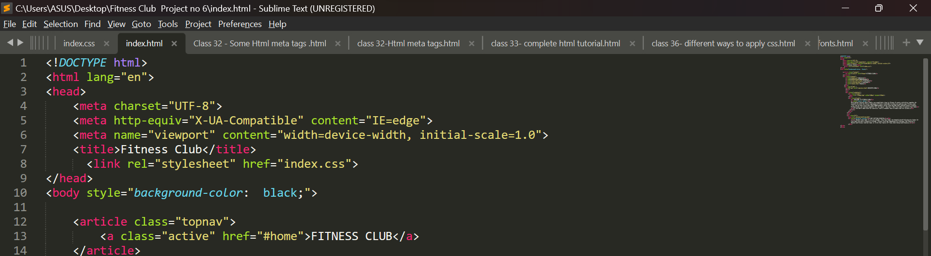
_{About Project}
1. Fitness club
A health club (also known as a fitness club, fitness center, health spa, and commonly referred to as a gym) is a place that houses exercise equipment for the purpose of physical exercise. In recent years, the number of fitness and health services have increased, expanding the interest among the population
_{2. Objective of your Project}
Fitness/Wellness Club Objectives 1) To provide an assortment of activities with an abundance of opportunities for every person to be successful. 2) To allow members to give feedback and share ideas to enhance the program. 3) To provide physical activity that will enable each person to monitor desired gains.
3. Briefly describe your Project
_{Header:-}

Slide 7
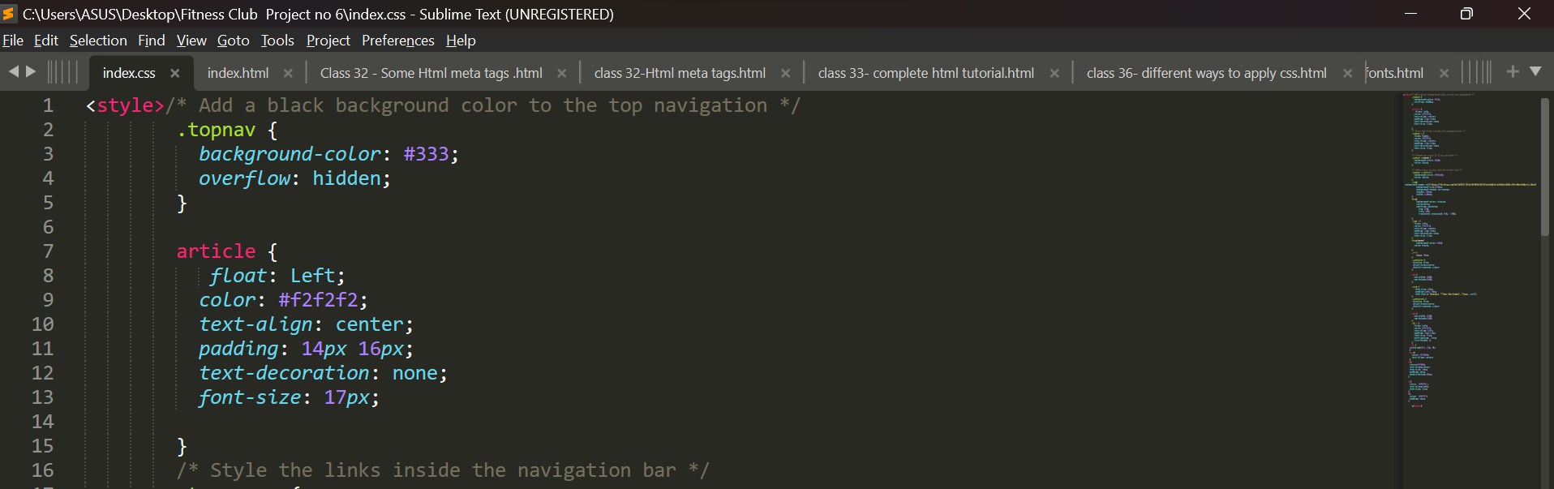
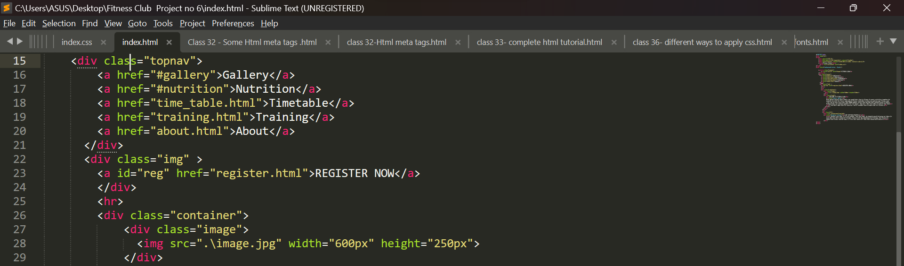
Navigation Bar:-

Slide 8
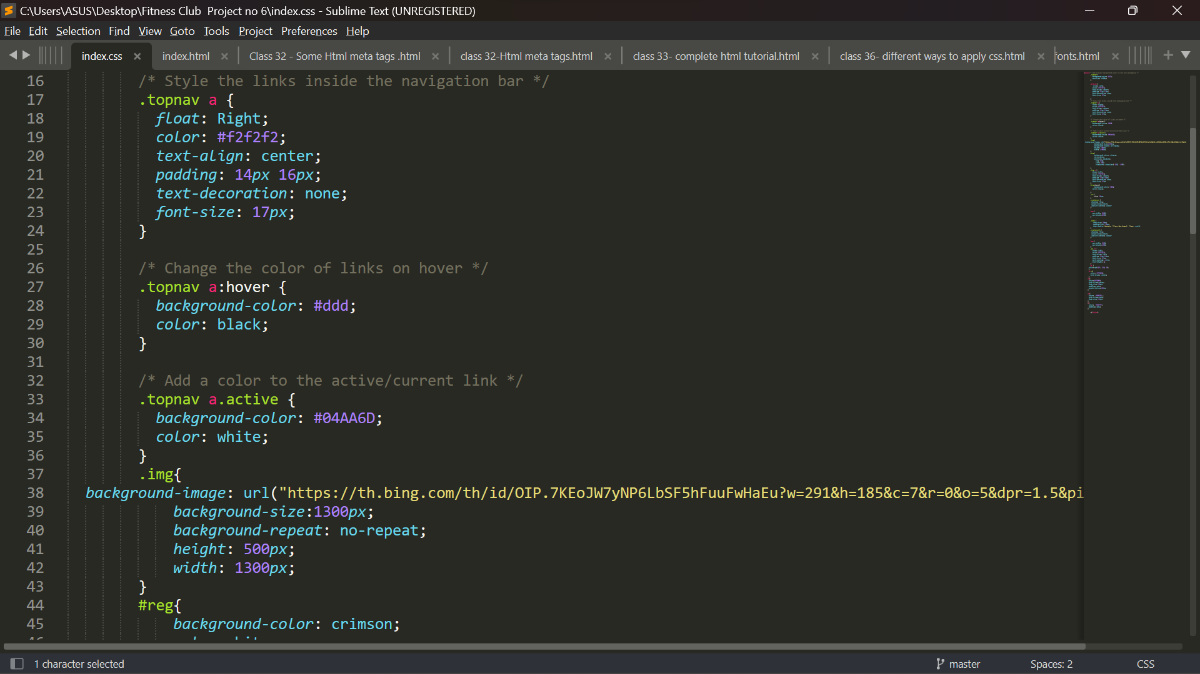
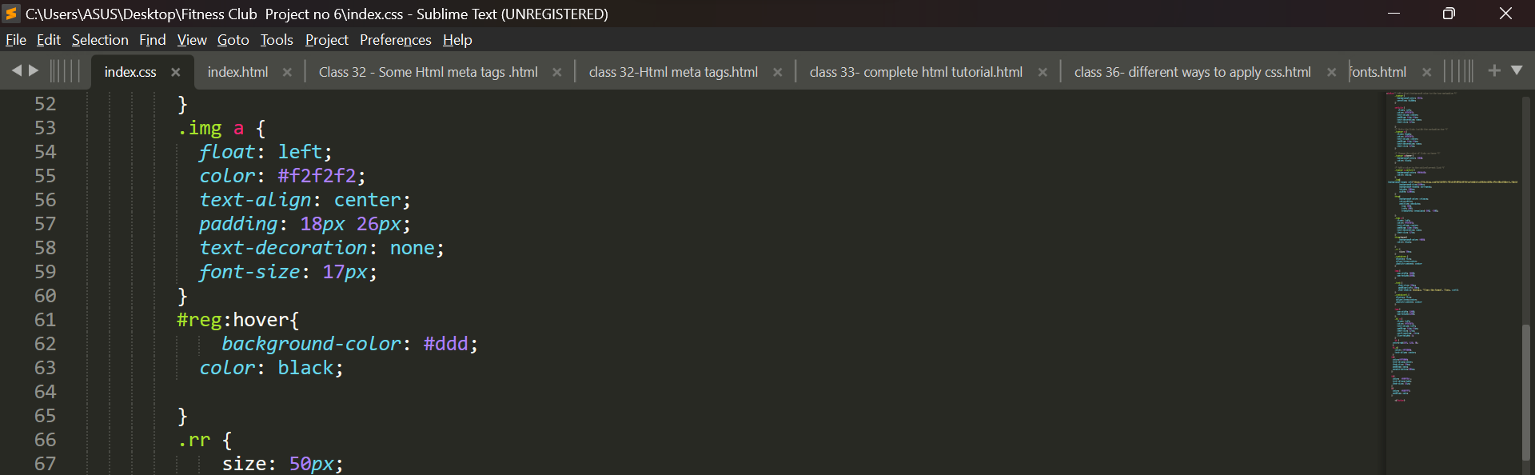

Slide 9
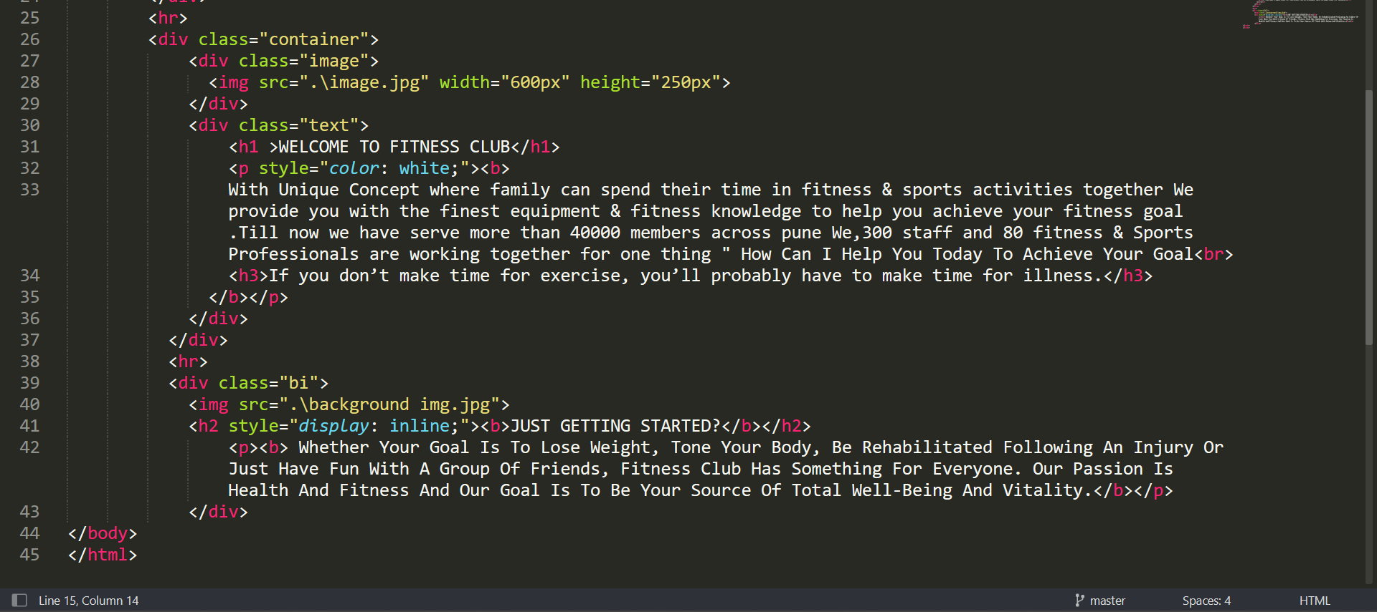
3. Paragraph Container:-

Slide 10
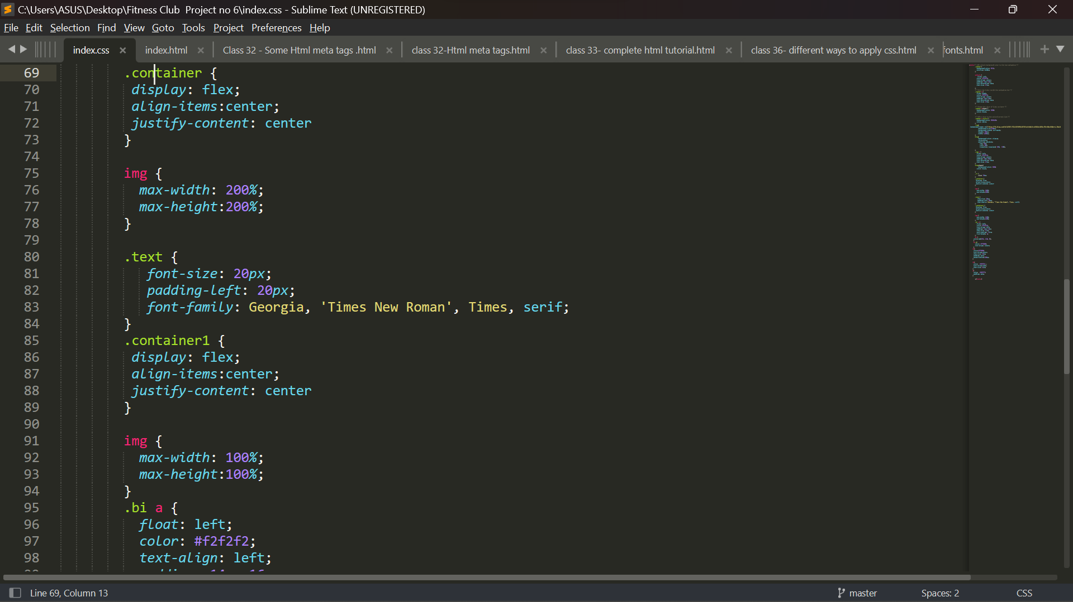
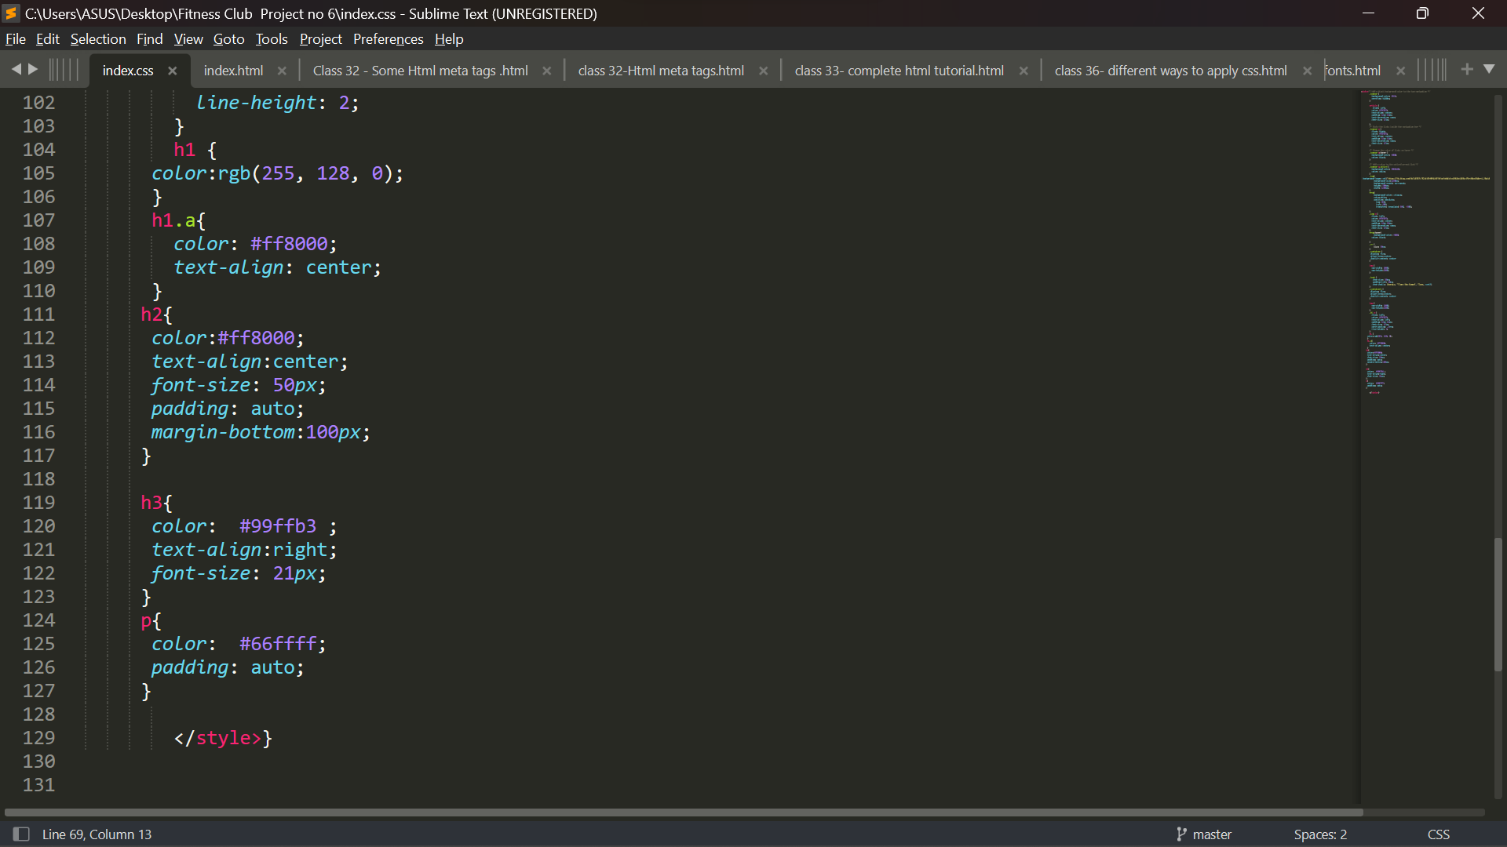

Slide 11
Thank
You

